Slide 1
CONTENT BASED IMAGE RETRIEVAL USING HEXAGONAL RESAMPLE AND DETECTION OF AILMENT IN MRI SCAN OF BRAIN

Slide 2
Introduction
Content based image retrieval, CBIR, involves looking for similar images based on the content of the images rather than the metadata as in text based image retrieval. Features such as color, shape and texture are extracted from the image and these serve as basis for further processing
Normal images are found to be in rectangular lattice, transforming them to hexagonal grid using re-sampling delivers improved feature parameters which in turn enhances the retrieval performance.
Feature extraction starts with detection of edges which provides shape parameters. Gabor wavelet based edge detection technique is used in this work. Gray Level Co-occurrence Matrix (GLCM) method is used to extract the texture parameters.
Based on the feature extracted Visual indication of three pathologies related to Human Brain Infarct ,tumor, bleed are provided.

Slide 3
Proposed Methodology
The CBIR technique used for retrieval process is explained in this section. Initially the algorithm is run on the image database of MRI scans of brain, the shape and texture feature parameters are extracted and stored in a feature vector. The image transformed to hexagonal grid using the resampling process explained above is used for the feature extraction processes. When the query image is loaded, it undergoes the same process of resampling and then feature extraction, the results of which are stored in a separate feature vector (query feature vector).

Slide 4
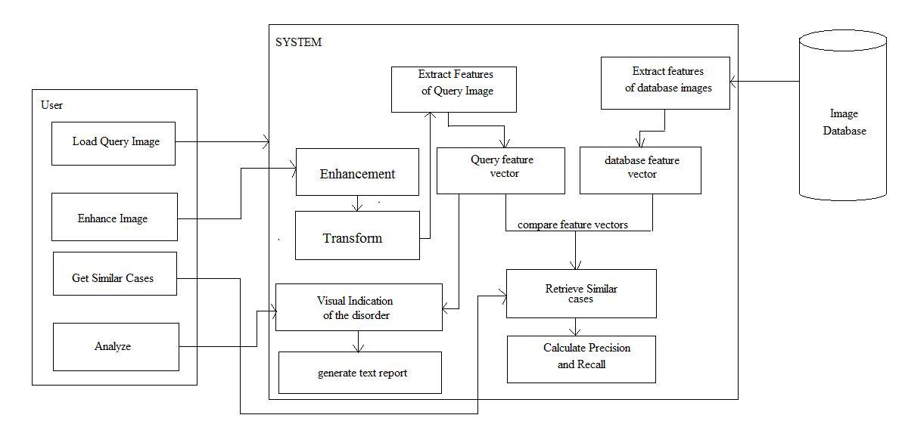
Architectural design of the system

Slide 5
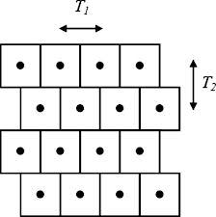
Hexagonal Sample Grid
The process of feature extraction is preceded by resampling. It involves transforming images present in rectangular lattice to hexagonal grid space based on the half pixel shift method .

Slide 6
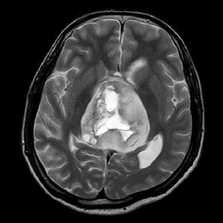
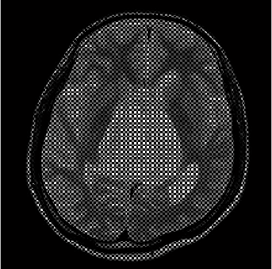
Query image
Resampled Image

Slide 7
Shape Feature Extraction
Shape can be described by simple geometric features such as moment of inertia, skew invariants, center of gravity etc. The extraction of shape features starts with detection of edges. For this purpose Gabor filter is applied on six scale values and three orientations – 0⁰, 60⁰, 120⁰, resulting in 6x3 = 18 edge-maps. Out of these only those satisfying the threshold value are superimposed to get the final edge-map.
The next step is to get the shape features by applying moment invariants.

Slide 8
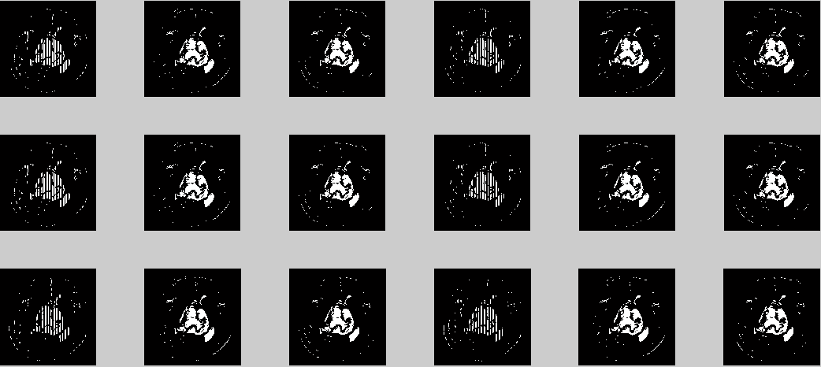
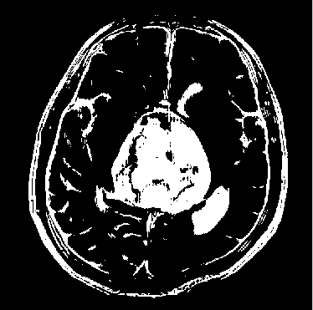
Gabor filter response
Final edge-map

Slide 9
Texture Feature Extraction
Important data regarding the structural arrangement of the surface is contained inside the texture features. Relationship between the surface and external environment can also be provided by them. For extraction of texture features, Grey Level Co-occurence Matrix is used.

Slide 10
Feature vector table
The texture values are appended to the previously stored shape feature values in the same vector.
Image Id | Shape features (7X4 = 28 values) | Texture features (13 values)

Slide 11
Distance Calculation
The database feature vector for all the images in the database is created in accordance with the above mentioned process of feature extraction so is the feature vector for the query image. The Euclidean distance between the query and each of the database feature vectors .

Slide 12
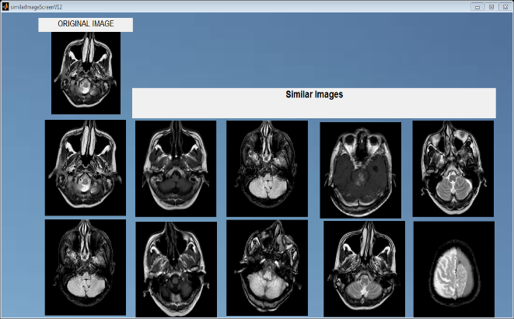
Retrieval output for a sample query image

Slide 13
Diagnosis Of Ailment
The second module of the system under study, consists of image analysis. Based on texture parameters the defects are detected and visual indication of the affected region is provided. Figure Below shows the segmented image obtained based on the texture energy values .

Slide 14
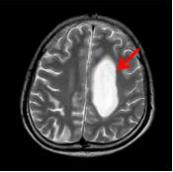
Visual Indication Of Affected Region
Tumour

Slide 15
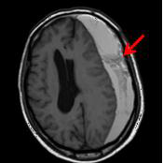
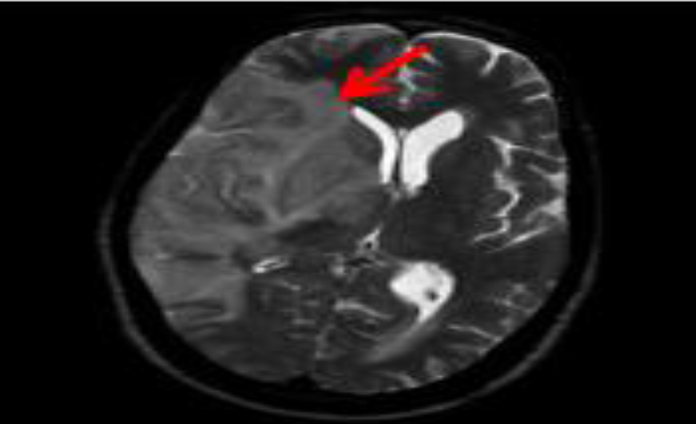
Bleed
Infarct

Slide 16
Retrieval Efficiency
For showing the efficiency of retrieval, precision and recall values were calculated for four randomly selected images from the 1500 images of brain MRI scan from MATLAB workspace database

Slide 17
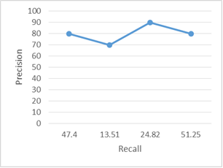
Table below shows the precision and recall values for the four query images randomly chosen. Precision varies from 70.0% to 90.0% and recall varies from 13.5% to 51.3%.
According to the table values, graphical representation of recall versus precision is shown

Slide 18
Acknowledgements
"The company of learned men is the key to the gates of wisdom". The satisfaction and euphoria that accompany the completion of any task would be incomplete without the mention of the people who made it possible, whose constant guidance and encouragement ground our efforts with success. We consider it a privilege to express our gratitude and respect to all those who guided us in completion of our project. We wholeheartedly thank Prof. Padmashree Desai, Associate Professor, Computer Science and Engineering, BVBCET-Hubli for her invaluable support and guidance.
We also thank Project co-ordinator, Prof. Vijayalaxm.M, Associate Professor, Computer Science and Engineering , BVBCET -Hubli ,whose guidance and knowledge was great use to us during this project work. We also like to thank Dr. Shah and Ms. Ujjwala at NMR Scan Centre for their co-operation and their extreme support.

Slide 19
Conclusion
This study proposed a model for Content Based Image Retrieval by using shape and texture features of the images. Shape features are extracted from the hexagonal resampled image using Gabor Filters. Using GLCM the texture features, are computed. Final feature vector table contains both shape and texture features, resulting in improved retrieval. The measure of similarity between the query image and the database images is done by calculating the Euclidean distance.. The second component of the system consists of detection of ailment in the MRI scans of human brain for three pathologies – tumor, bleed and infarct. Texture features, calculated above, are used for the identification of abnormalities taken in consideration for this work. Visual indication is provided for the affected region in the brain for assistance to the doctors or other medical professionals in the process of analysis. The system has been developed successfully in an efficient manner to achieve the expected output. The system is designed with flexible and consistent flow for easy understanding.

Slide 20
References
“Using Moment Invariants For Classifying Shapes On Large Scale Maps” Laura Keyes, Adam Winstanley; Department of Computer Science, National University of Ireland Maynooth, Co. Kildare, Ireland.
“Visual Pattern Recognition by Moment Invariants”, M. K. Hu, IRE Trans. Info. Theory, vol. IT-8, pp.179-187, 1962
“Hexagonal wavelet processing of digital, mammography”, A. Laine, S. Schuler, Medical Imaging 1993, Part of SPIE’s Thematic Applied Science and Engineering series, Newport Beach, California, February 14-19,1993.
"Textural Features for Image Classification", Haralick, R.M., K. Shanmugan, and I. Dinstein, IEEE Transactions on Systems, Man, and Cybernetics, Vol. SMC-3, 1973, pp. 610-621.
“Computer and Robot Vision: Vol. 1”, Haralick, R.M., and L.G. Shapiro., Addison-Wesley, 1992, p. 459
“Content Based Medical Image Retrieval with Texture Content Using Gray Level Co-occurrence Matrix and K-Means Clustering Algorithms”, Ramamurthy, B. and K.R. Chandran; 1Department of CS, Sri Ramakrishna Engineering College, Coimbatore, India Department of CIS, PSG College of Technology, Coimbatore, India

Slide 21
Contd…
“Rock texture retrieval using gray level co-occurrence matrix. Tampere University of Technology”, Partio, M., B. Cramariuc, M. Gabbouj and A. Visa, 2002.
“Image information retrieval from incomplete queries using color and shape features”, Keshri Verma, Bikesh Kumar Singh, A. S. Thoke and Ankita Chan-drakar. Vol. 2(No. 4), December 2011.
“Matlab as a tool in nuclear medicine image processing” Agapi Ploussi, Maria Lyra and Antonios Georgantzoglou, Radiation Physics Unit, A’ Radiology Department University of Athens, Greece, 2011.
“Hexagonal parallel pattern transformation”, M.Golay, Vol. 18(No. 8):733-740, 1969.
“Content based medical image retrieval with texture content using gray level co-occurrence matrix and k-means clustering algorithms”, B. Ramamurthy, Coimbatore India Department of CIS PSG College of Technology Coimbatore and K.R. Chandran Department of CS, Sri Ramakrishna Engineering College, 2012.
“The process of hexagonally sampled two dimensional signals”, R.M.Mersereau, Vol. 67:930-949, 1979.
“Image enhancement of medical images using gabor filter bank on hexagonal sampled grids”, K.A.Narayanankutty and Veni.S. 2003.

Slide 22


